Slide 1
Use Node.js and PowerShell to work with SharePoint data
Chendrayan Venkatesan (Chen V)
Infrastructure Automation Lead Engineer

Slide 2
Agenda
CSOM (Client Side Object Model)
Microsoft PowerShell
Node.js | Express | PUG
What RESTful API can do?
About SHiPS PowerShell module!
Demo
Building Web Apps and RESTful API | child_process (PowerShell / Python)
Deploy as Windows Service(s) – Microservices!

Slide 3
Client Side Object Model

Slide 4
Client Side Object Model
Used for building Client Side Applications which was introduced in SharePoint 2010.
Allows to work with SharePoint without web services
Subset of Server Object Model.
Language flexibility (.NET, Silverlight , ECMA[JAVASCRIPT])
Performance Optimization.

Slide 5
Microsoft PowerShell

Slide 6
Microsoft PowerShell
PowerShell is a task based command-line shell.
More than a scripting language built on the .NET Framework.
Power users and Admins to rapidly automate tasks.
PowerShell includes rich expression parser and a fully developed scripting language.
Verb-Noun makes life easier.
Object Orientation.
Get Started with Windows PowerShell
Set up and Installation.
Tutorials

Slide 7
Node.JS | Express | PUG

Slide 8


Node.js | Express | PUG
Node.js
Express
PUG
Open Source, cross-platform.
JavaScript run time environment.
Minimalist web framework for node.js
Flexible and Robust.
A middleman | Template Engine
Intended HTML
Get Node.js 8.11.3 LTS or 10.7.0
npm install express –s
npm install pug –s

Slide 9
What RESTful API can do?

Slide 10
RESTful Operations
GET
Retrieves a resource.
POST
Creates a new resource.
PUT
Updates an existing resource.
DELETE
Removes a resource.
No much side effect.
Cacheable

Slide 11
Building web apps and RESTful API

Slide 12
Child_Process
An event emitter
Subjected to use with (Creates an instance)
SPAWN()
EXEC()
EXECFILE()
FORK()
Has three streams
Stdin | Stdout | Stderr
Reference Link
Child_Process
Good Blog about Child_Process.

Slide 13
Let’s Get Started!

Slide 14

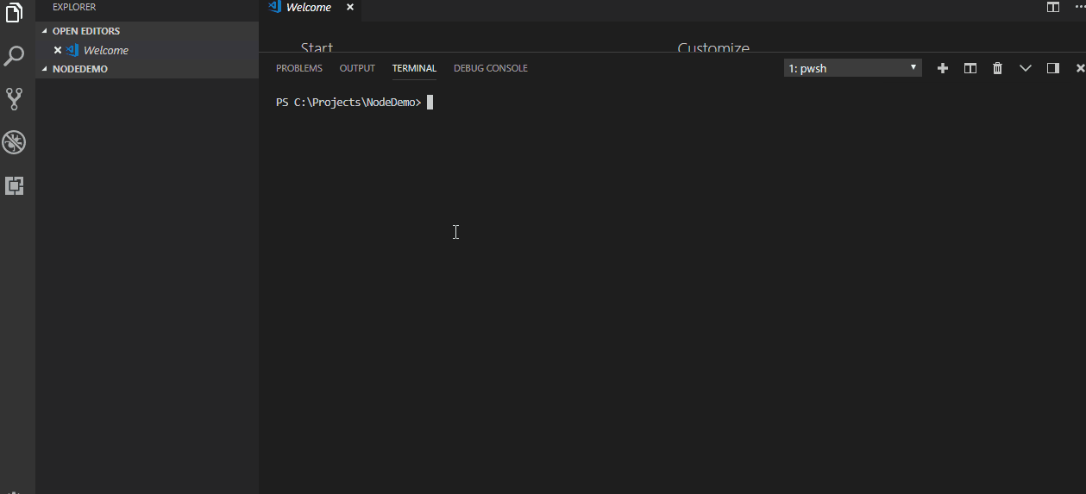
Yes! You Can!

Slide 15
CSOM | Node.js | PUG | Express | PowerShell | Event Content
Notes:
CSOM

